Slide 1
Recursion
The snake is biting its own tail
Recursion / Lecture 2
Go to www.menti.com and use the code 4831 7794
Franck Chauvel
axbit & NTNU
franck.chauvel@ntnu.no

Slide 2
Sum of Integers
def sum_of_integers(n):
sum = 0
for i in range(n+1):
sum += i
return sum
How to rewrite this without a loop nor the known formula?
USE RECURSION

Slide 3
Agenda
What is “Recursion”?
Recursion in Computer Science
How to design “recursive” procedures?
Recursion vs. Iteration
Recap

Slide 4

What is “recursion”?
“Recursion occurs when a thing is defined in terms of itself or of its type”.
—Wikipedia
A procedure that calls itself
A data type that refers to itself

Slide 5
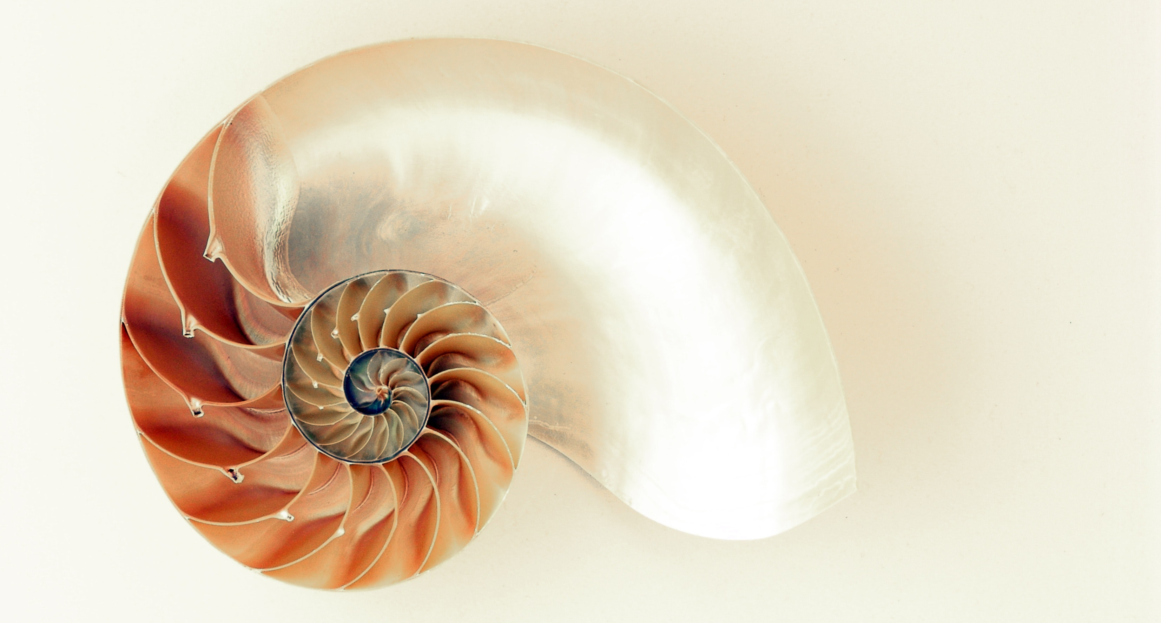

In Nature Examples of Recursions

Slide 6
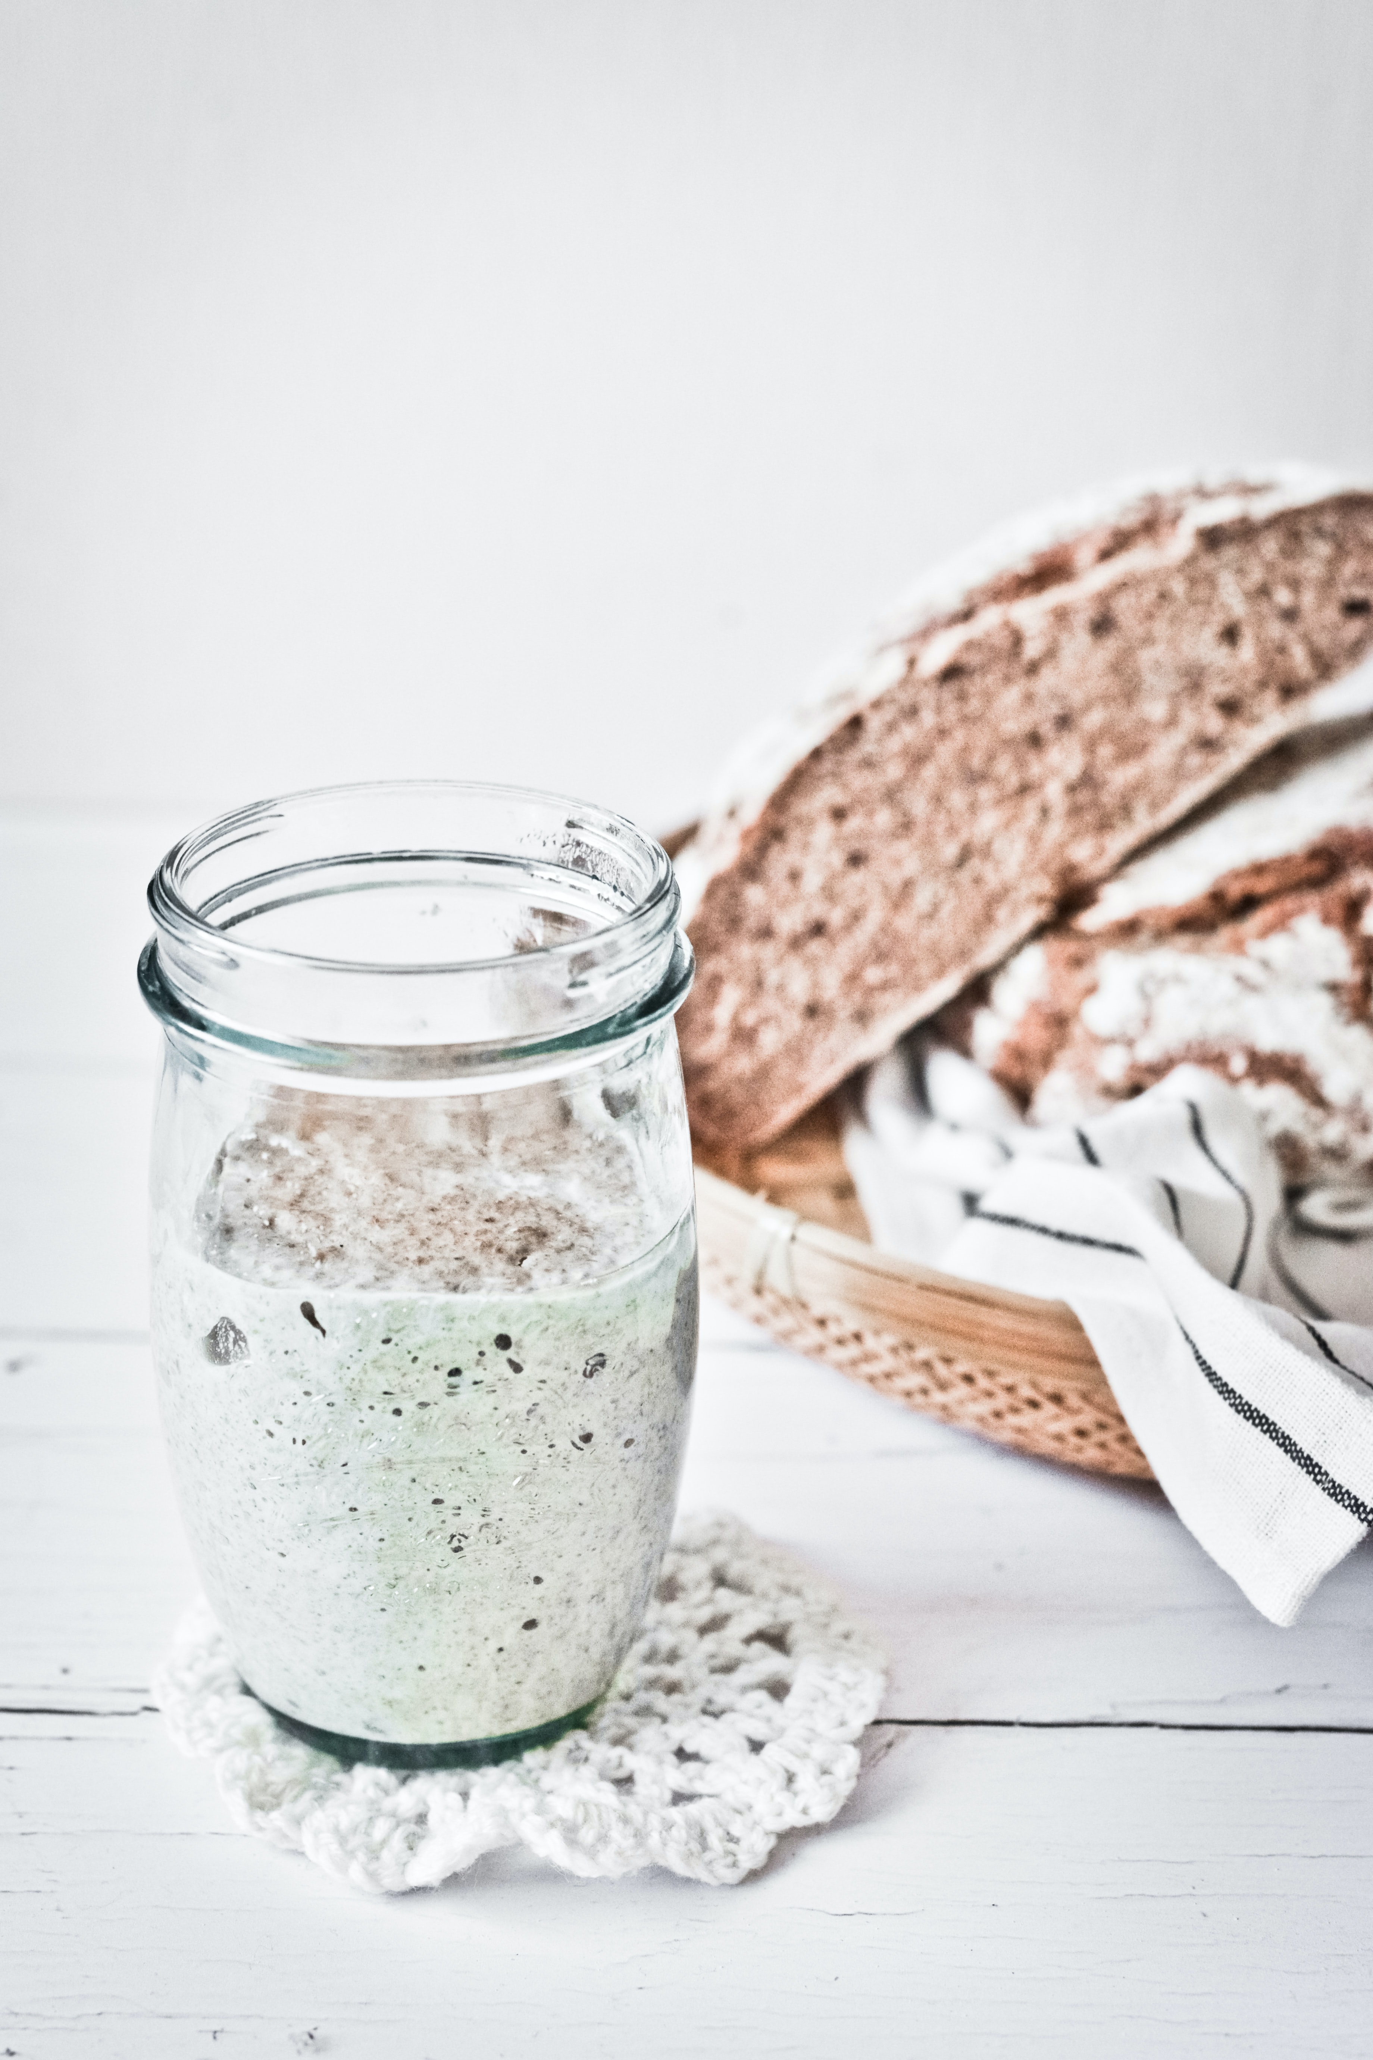
In Cooking Examples of Recursions
Photo by Margaret Jaszowska on Unsplash
How to make 200 g of sour dough?
Take 100 g of sour dough
Add 50 g of water
Add 50 g of flour
Let it rest

Slide 7
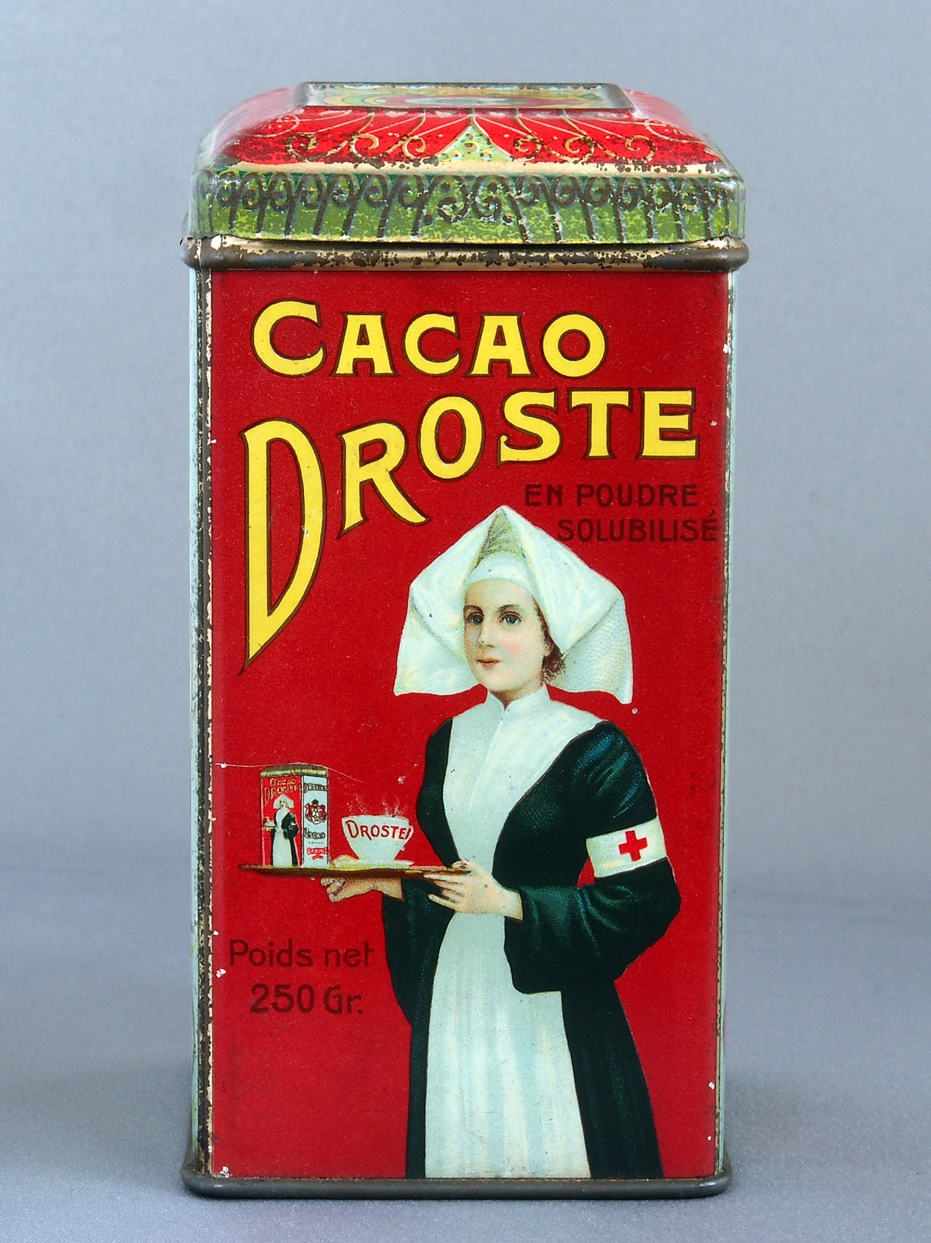

In Arts Examples of Recursions
Place a copy of the image in itself!

Slide 8
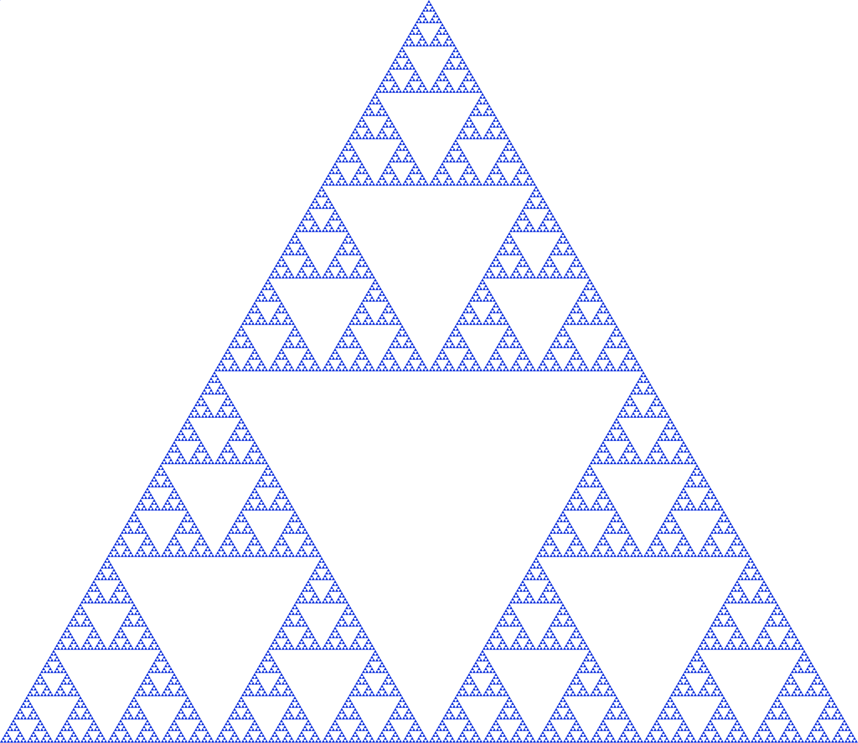
In Maths Examples of Recursions
Geometry, fractals
Recurrence relation
Difference equations

Slide 9
In Computer Science
Recursive Data Type
Recursive Procedure
class List<T> {
T item;
List<T> next;
}
def sum_of_integers(n):
if n==1:
return 1
return n + sum_of_integers(n-1)

Slide 10
Lists Recursive Data Type
Lists
List Data Type
1
class List<T> {
T item;
List<T> next;
}
2
3
4

Slide 11
Trees Recursive Data Type
Tree Data Type
1
class Tree<T> {
T item;
Sequence<Tree<T>> next;
}
2
3
4
5
6
7
8
9
A
A

Slide 12
Sum of Integers Recursive Procedures
def sum_of_integers(n):
sum = 0
for i in range(n+1):
sum += i
return sum
def sum_of_integers(n):
if n==1:
return 1
return n + sum_of_integers(n-1)

Slide 13
Factorial
def factorial(n):
total = 1
for each in range(1, n+1):
total *= each
return total
def factorial(n):
if n == 1:
return 1
return n * factorial(n-1)

Slide 14

Binary Search
def search(array, value):
lower = 0
upper = len(array)
while (upper - lower) > 1:
split = (upper + lower) // 2
if value == array[split]:
return split
elif value < array[split]:
upper = split
else:
lower = split
return -1

Slide 15
Recursive Version of the Binary Search
def search(array, value):
return do_search(array, 0, len(array), value)
def do_search(array, lower, upper, value):
split = (lower + upper) // 2
if value == array[split]:
return split
elif value < array[split]:
return do_search(array, lower, split, value)
else:
return do_search(array, split, upper, value)

Slide 16
3. How to design with Recursion?

Slide 17
Thought Process
def sum_of_integers(n):
if n==1:
return 1
return n + sum_of_integers(n-1)
base case

Slide 18
Alternatives

Slide 19
A Methodology
Is there a recursive data type?
Break down the problem into self-similar sub-problems of smaller size
What are the base cases?
What are the recursive cases?

Slide 20
Expressiveness Recursion vs. Iteration
Recursion
Iteration

Slide 21
Efficiency
def sum_of_integers(n):
sum = 0
for i in range(n+1):
sum += i
return sum
def sum_of_integers(n):
if n==1:
return 1
return n + sum_of_integers(n-1)
print(sum_of_integers(1000))
print(sum_of_integers(1000))
500500
[Previous line repeated 995 more times]
File "/Users/fchauvel/…/recursion.py", line 2, in sum_of_integers
if n==1:
RecursionError: maximum recursion depth exceeded in comparison

Slide 22
Performance Recursion vs. Iteration
Call-stack
Time: Recursion = Iteration
Memory: Recursion > Iteration
Procedures calls are pushed onto the call stack!
The call stack may grow too big!
Call-stack
Free Memory
Call-stack
growth
!
Heap
Heap
growth
Static data
Address
Program Instructions

Slide 23
Slow Motion
Stack
Previous frames
n = 5
result = ??
def sum_of_integers(n):
if n==1:
return 1
return n + sum_of_integers(n-1)
n + 10 = 15
n = 4
result = ??
n + 6 = 10
n = 3
result = ??
n + 3 = 6
print(sum_of_integers(5))
n = 2
result = ??
n + 2 = 3
Address
n = 1
result = 1

Slide 24
Efficiency
def sum_of_integers(n):
if n==1:
return 1
return n + sum_of_integers(n-1)
Computing efficiency of recursive algorithm
requires a recurrence relationship

Slide 25
Tail Call Optimisation
Stack
Previous frames
def sum_of_integers(n):
return do_sum(0, n)
def do_sum(acc, n):
if n == 1:
return acc + 1
return do_sum(acc+n, n-1)
n = 5 4 3 2 1
acc = 0 5 9 12 14
n = 5
acc = 0
n = 5 4
acc = 0 5
n = 5 4 3
acc = 0 5 9
n = 5 4 3 2
acc = 0 5 9 12
Address
print(sum_of_integers(5))

Slide 26
Tail Call Optimization
Language | Paradigm | TCO? | Note
C/C++ | Procedural |  | Yes for GCC
Python | Multi
Ruby | Multi | Yes | Optional
JavaScript | Multi | Yes | In ECMAScript v6
Java | OO
C# | OO
Scheme | Functional | Yes
Haskell | Functional | Yes
Ocaml | Functional | Yes
Scala | Functional | Yes

Slide 27
Recap
Recursion
Data type that refer to themselves
Procedures that call themselves
Recursion vs. Iteration?
Same expression power
Recursion takes more memory
Design strategy
What is the underlying structure
Base cases
Recursive cases
Efficiency
Recurrence relationship

Slide 28
Questions, Comments, or Ideas?
Franck Chauvel
axbit & NTNU
franck.chauvel@ntnu.no

Slide 29
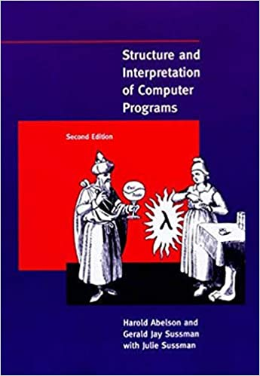
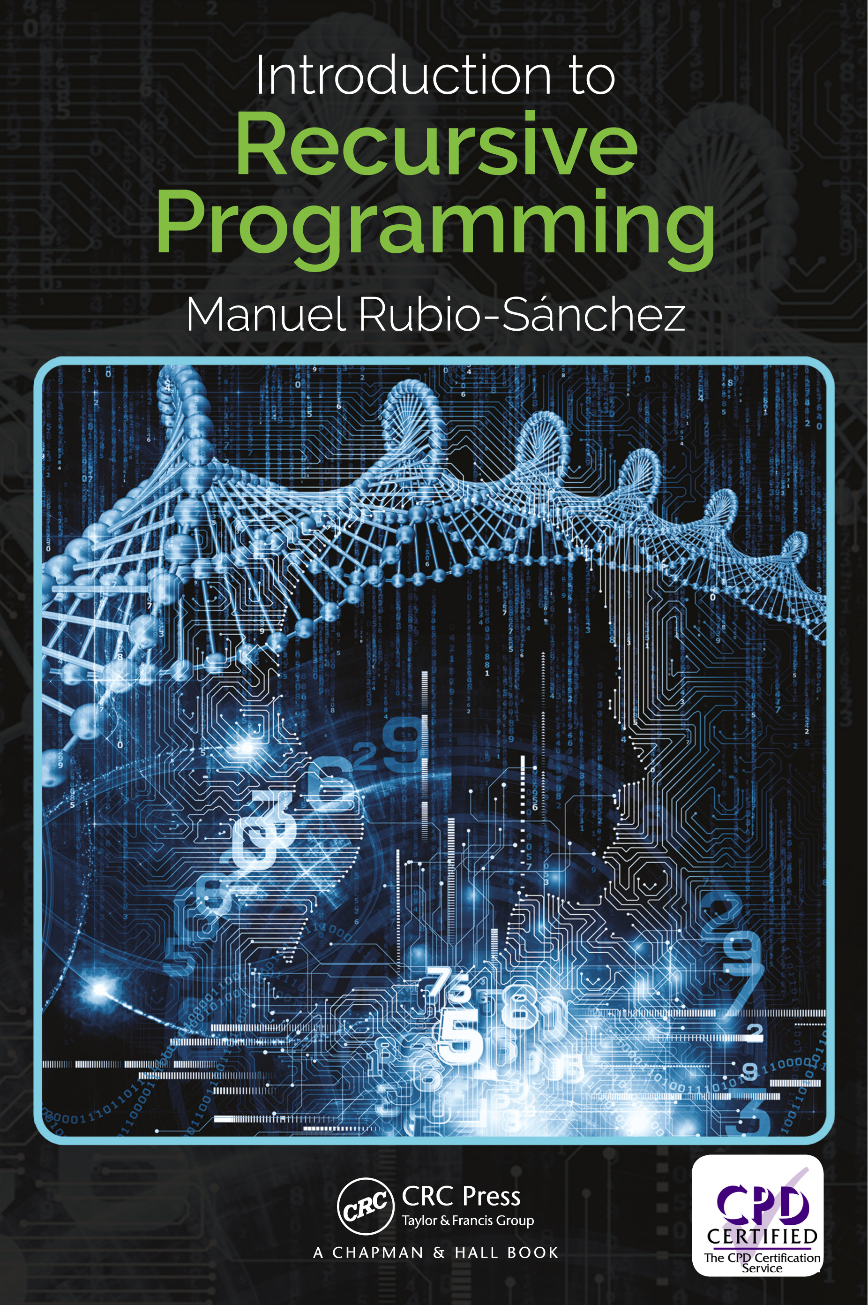
Relevant Readings
Abelson, Harold, and Gerald Jay Sussman. Structure and interpretation of computer programs. The MIT Press, 1996.
Rubio-Sánchez, Manuel. Introduction to recursive programming. CRC Press, 2017.

